Slide 1
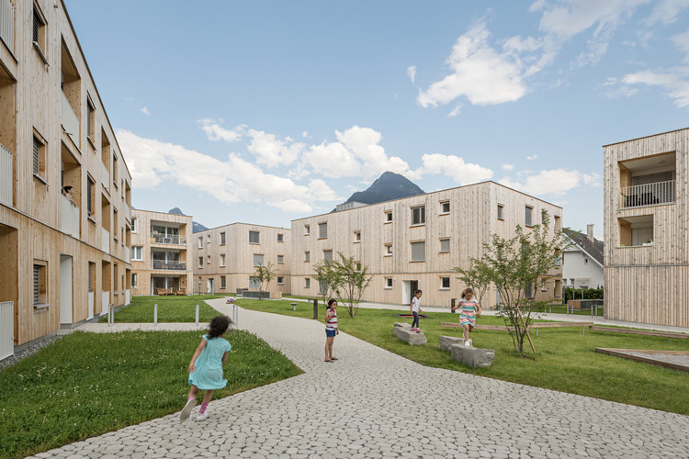
Synthetic Property Rent Data Analysis

Slide 2

Problem Statement: Predicting Property Rental Prices in a Metropolitan Area.

Slide 3
Synthetic Property Rent Data
10,000 observations and 78 features
Cleaning Requirement
Dataset show collection of property rental, designed to mimic real world rental market trends.
Python and it’s libraries use for the Analysis
Project
Overview

Slide 4

Goals
Analysis the relationship between property characteristics and rent price.
Identify key factors influencing rent price.
Develop predictive models to estimate rent price based on property features.
Visualize rental market trends and patterns.

Slide 5
Objective
To build a robust predictive model that accurately estimates rent prices based on property characteristics.

Slide 6

Project(code) Explanation

Slide 7
Conclusion
Identify significant predictors of rent prices, such as property type, no of bedrooms, size.
Develop accurate predictive models using Linear Regression techniques.
Visualize rental market trends, including impact of proximity to public transport and neighborhood safety
According to year Rent prices are increases as per year increases.

Slide 8


